Slide 1


DESIGN AND IMPLEMENTATION OF ENERGY MONITORING USING Wi-Fi NETWORK
By
P SUMANTH 15211A04E9
Under the Guidance of
Dr. T. Vasudeva Reddy
Associate Professor, M.tech, Ph.D
Electronics and Communication Engineering

Slide 2
Contents
Introduction
Motivation
Objective
Literature survey
Abstract
Block diagram
Components
Application
Conclusion

Slide 3
Introduction
Extension to Wireless Power Saving Using TI-MSP
MSP430
G2553
RELAY
ON/OFF
PIR
(HC-SR502)
ULTRASONIC
(HC-SR04)
NODEMCU WIFI MODULE

Slide 4

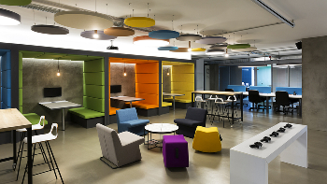

Motivation
Home applications
Companies
Educational sectors

Slide 5

Objective
Energy is monitored over a period of time i.e daily, weekly, monthly.
Reduce hardware components.
Accurate Results of power consumed and displayed in the data sheet with the help of Google firebase.

Slide 6
Literature survey
Home Electric Energy Monitoring System Design and Prototyping. - ResearchGate website(2011)
by J.G. Josue, J.M. Pina, and M.V. Neves
Smart Home Energy Monitoring & Management System
- Instructables website
by Abhishek

Slide 7
Abstract
The energy resource management is a major concern worldwide. Energy management activities minimize environmental impacts of the energy production. Therefore, electric energy consumption monitoring has been proposed as an important process which makes immediate reductions in energy use. This Project requires less hardware. The hardware consists of MSP430 G2553 launch pad, NodeMCU. Google firebase, Excel sheets and MIT app inventor are used to store and load the power consumed by electrical appliances over a period of time. The arithematic operations like calculating time period, multiplying with power factor is performed in the MIT app inventor.

Slide 8
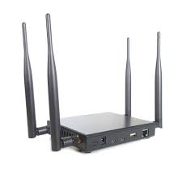
Block Diagram
Transmitter:
Tx
Rx
Receiver:
RELAY
MSP430
G2553
NodeMcu
3.3V battery
GOOGLE
Firebase
Mobile APP
Excel Sheet

Slide 9
Components
HARDWARE:
MSP430 G2553
NodeMCU
SOFTWARE:
Energia IDE
Arduino IDE
MIT App inventor 2
Firebase Console
Excel sheet

Slide 10
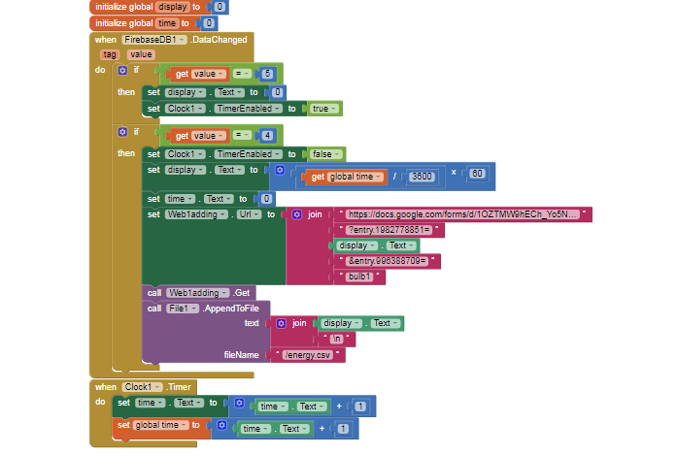
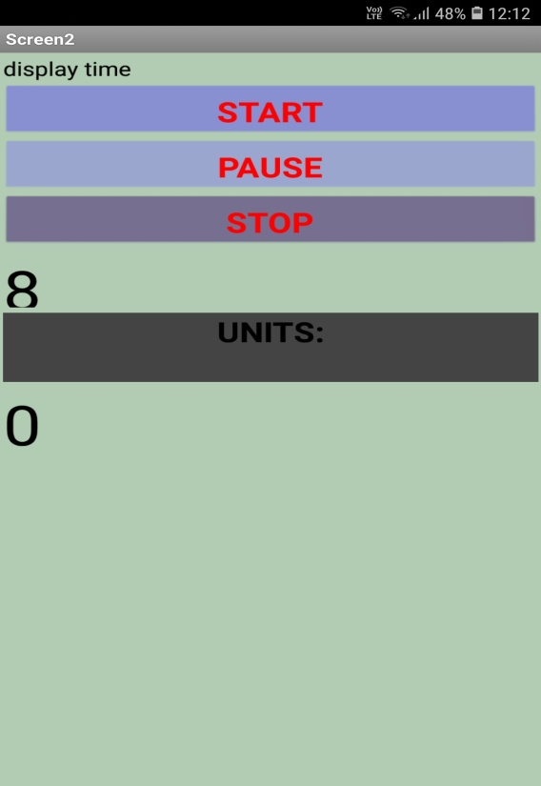
Outputs
MOBILE APPLICATION

Slide 11
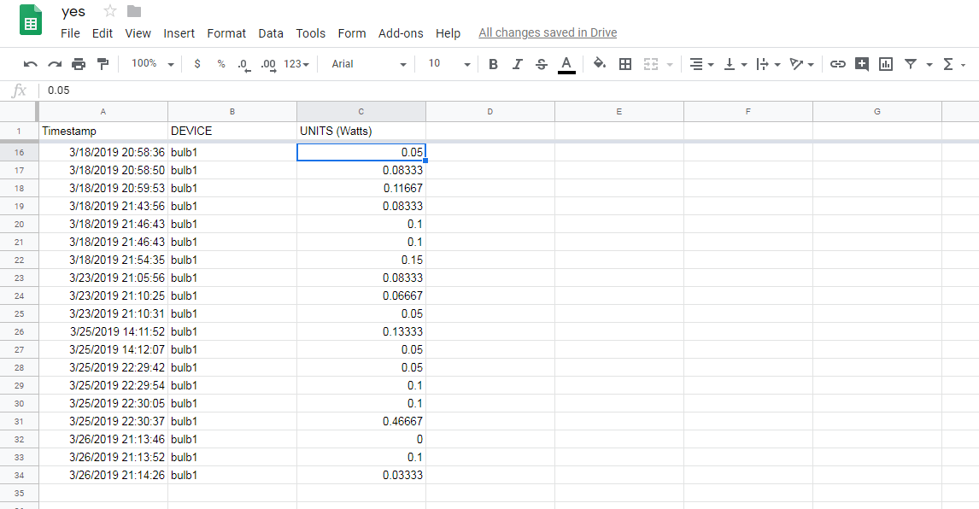
Outputs
EXCEL SHEET

Slide 12
Applications
Houses
Offices
Schools
Conclusion
User friendly
Up to date results with any delay
Easily configurable

Slide 13
THANKING YOU

